Slide 1
FREMONT UNIFIED SCHOOL DISTRICT
Educate • Challenge • Inspire
PROPOSED CHANGE to weiBEL & LEITCH/WARM SPRINGS boundary
August 6, 2014

Slide 2
Outline
Districtwide Enrollment Trend
Enrollment by Attendance Area
Leitch/Warm Springs Enrollment Trend
Weibel Enrollment Trend
Addressing Overcrowding
Proposed Boundary Change
Implementation Plan

Slide 3
Districtwide Enrollment Trend
Enrollment Growth in the last 6 years – 1,962 or 1% each year
Projected Growth in the next 4 years – 1,574 or 1.1% each year

Slide 4
K-12 Enrollment Trend By Attendance Area

Slide 5
Leitch/Warm Springs Enrollment Trend
Enrollment Growth in the last 6 years – 540 students or 5.9% each year
Projected Growth in the next 4 years – 290 students or 4.3% each year

Slide 6
Weibel Enrollment Trend

Slide 7
Addressing Overcrowding
Installation of 9 temporary classrooms at Leitch available at the beginning of 2014-15
  Most 3rd grade students will be at Leitch for 2014-15, until permanent classrooms are constructed at Warm Springs
Construction of 12 permanent classroom at Warm Springs coming soon
  Targeted completion will be fall of 2015
Proposed change to Weibel & Leitch/Warm Springs boundary for board approval on August 13, effective 2015-16

Slide 8
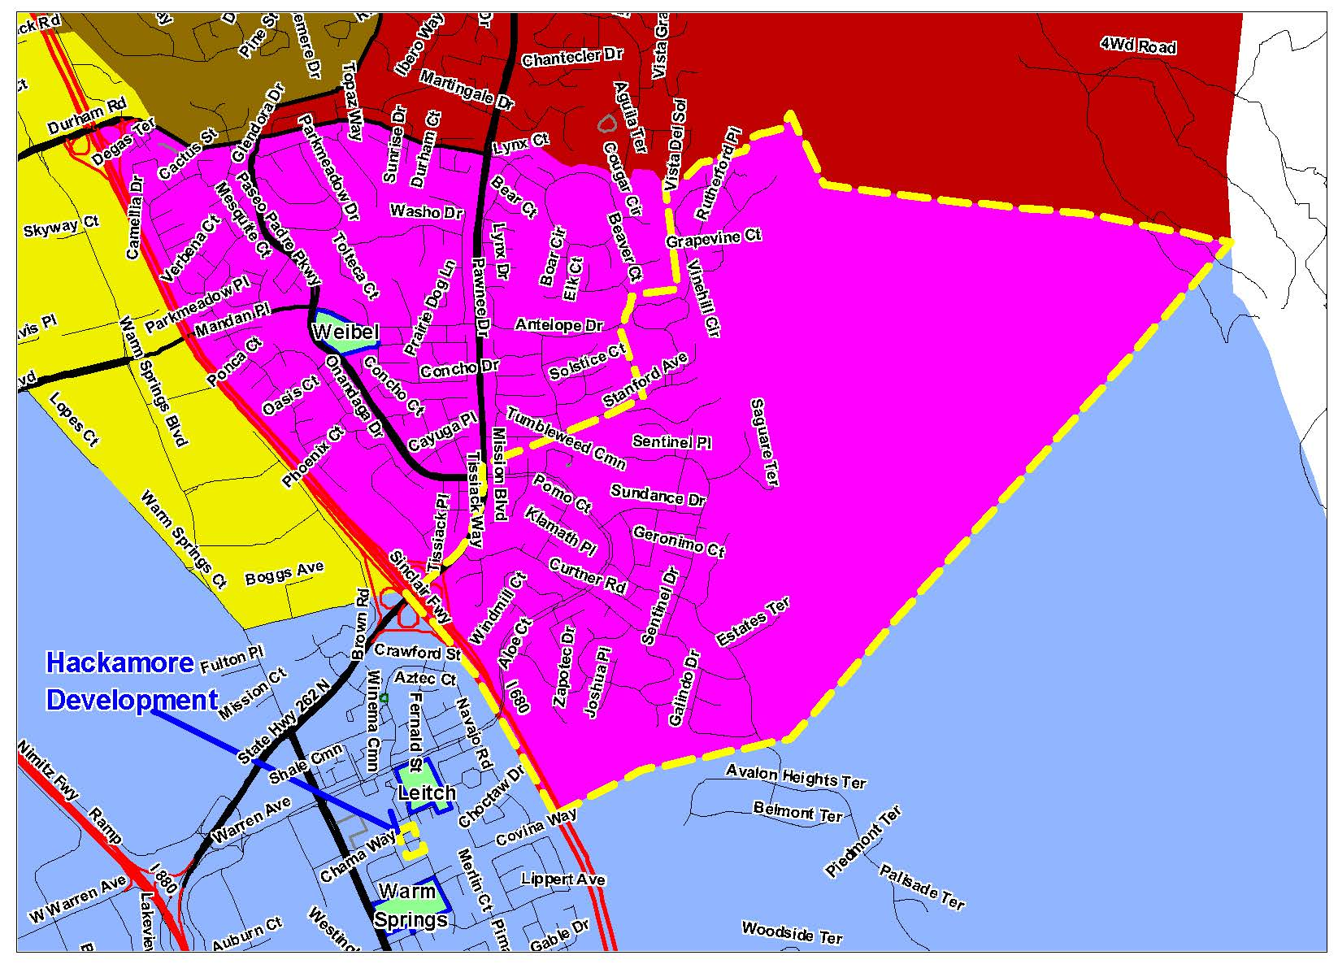
Proposed Change in Boundary

Slide 9
Number of Students in the Subject Area
School of Attendance | K | 1 | 2 | 3 | 4 | 5 | 6 | Total
Azevada | 1 |  | 1 |  |  |  |  | 2
Chadbourne |  |  | 1 |  |  |  |  | 1
Grimmer |  |  |  |  | 1 |  |  | 1
Leitch | 14 | 11 | 21 | 1 |  |  |  | 47
Warm Springs |  |  |  | 4 | 18 | 12 | 22 | 56
Warwick |  |  | 1 |  |  |  |  | 1
Weibel | 4 |  | 1 | 1 | 7 | 4 | 5 | 22
Total | 19 | 11 | 25 | 6 | 26 | 16 | 27 | 130

Slide 10
Implementation Plan
For 2014-15, parents of students who live in the subject area may apply for intra-district transfer for early move base upon availability of space
Students who live in the subject area and attend Leitch/Warm Springs may choose to stay at the current school
  Leitch through grade 2 or 3
  Warm Springs through grade 6
Students from Hackamore development will be assigned to Leitch/Warm Springs, effective immediately
All students will attend Horner Junior High and Irvington High School

Slide 11
Implementation Plan
Grade | 14-15 | 15-16 | 16-17 | 17-18 | 18-19 | 19-20 | 20-21
K | Leitch
1 | Leitch | Leitch
2 | Leitch | Leitch | Leitch
3* | Leitch | Weibel | Weibel | Weibel
4 | Warm Springs | Weibel | Weibel | Weibel | Weibel
5 | Warm Springs | Warm Springs | Weibel | Weibel | Weibel | Weibel
6 | Warm Springs | Warm Springs | Warm Springs | Weibel | Weibel | Weibel | Weibel
* If your child is 3rd grade at Leitch

Slide 12
Implementation Plan
Grade | 14-15 | 15-16 | 16-17 | 17-18 | 18-19 | 19-20 | 20-21
K | Leitch
1 | Leitch | Leitch
2 | Leitch | Leitch | Leitch
3* | Warm Springs | Weibel | Weibel | Weibel
4 | Warm Springs | Warm Springs | Weibel | Weibel | Weibel
5 | Warm Springs | Warm Springs | Warm Springs | Weibel | Weibel | Weibel
6 | Warm Springs | Warm Springs | Warm Springs | Warm Springs | Weibel | Weibel | Weibel
If your child is 3rd grade at Warm Springs

Slide 13
Questions, comments, input

